Slide 1
Spectrum Sensing in Cognitive Radio using DetectNet
Guide
Dr. K Kannan
Professor
School of Computing
Team
Bala Shanmugam M
Shyam Kumar Reddy K

Slide 2
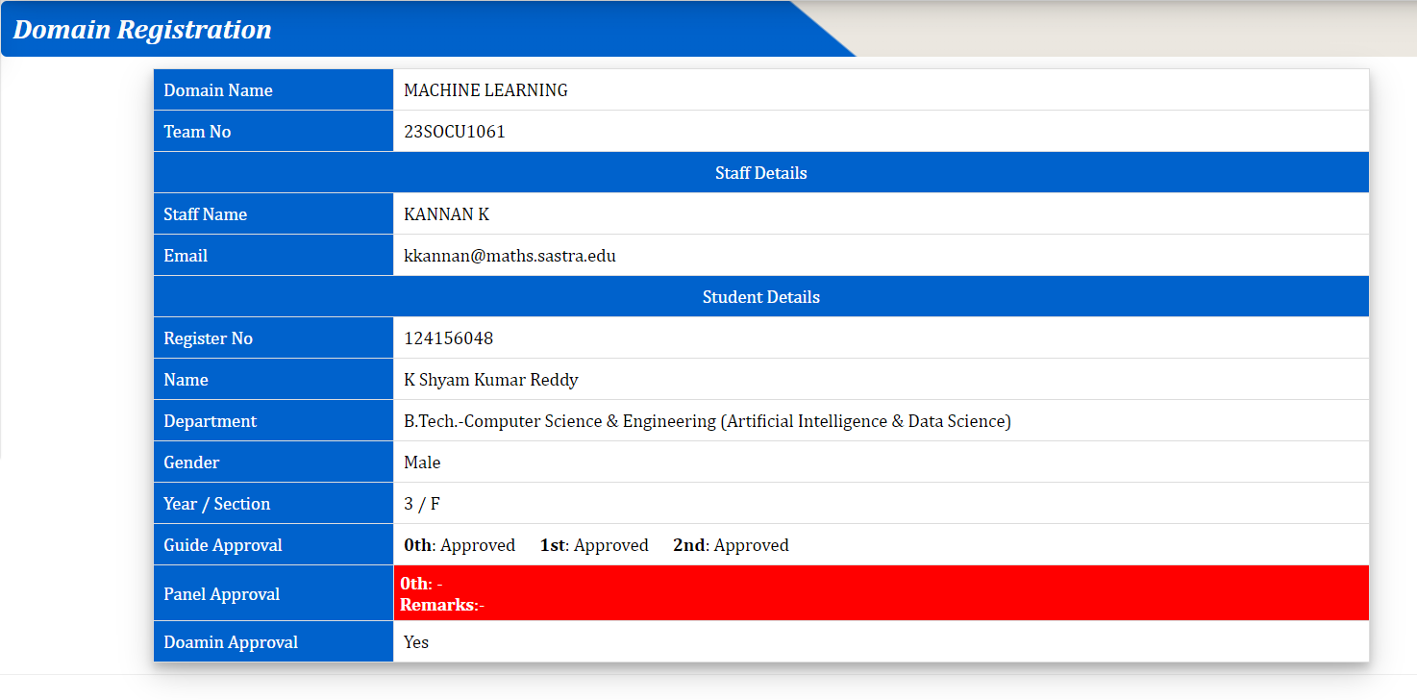
Project approval

Slide 3
Paper details
Deep Learning for Spectrum Sensing
IEEE WIRELESS COMMUNICATIONS LETTERS, VOL. 8, NO. 6, DECEMBER 2019
Jiabao Gao, Xuemei Yi, Caijun Zhong , Xiaoming Chen , and Zhaoyang Zhang
https://ieeexplore.ieee.org/document/8824091

Slide 4
Abstract
Wireless users will need to quickly sense large portions of the spectrum and opportunistically access unutilized bands in order to access shared bandwidth fairly.
DetectNet, a software framework is proposed
This is for a real-time wideband spectrum sensing that
1. heavily integrates real-time deep learning into the baseband processing logic of the transceiver
2. to identify and exploit unutilized spectrum bands.
In order to automatically extract the most information with the fewest I/Q (Inphase/ Quadrature) samples, DetectNet analyses a small fraction of the raw baseband waveform using a convolutional neural network (CNN) and Long Short Term Memory (LSTM).

Slide 5
Problem Statement
To identify the existence of a signal in a particular frequency band at a given time and then to determine the digital modulation type being employed in the spectrum.
To analyse the impact of SNR in classifying modulation

Slide 6
Objectives
Select higher accurate deep learning method for classification of modulations present in the signal and analyse the impact of SNR in this classification
Deep learning models covered are:
DNN
CNN
LSTM
CNN + LSTM (CLDNN )

Slide 7
Literature Survey
S.No | Title | Journal | Link | Limitations Or takeaways
1 | Spectrum sensing based on deep learning classification for cognitive radios | IEEE Wireless Communications 2020 | https://ieeexplore.ieee.org/document/9020304 | Didn’t tested for large-scale real-world dataset Done for simulated dataset
2 | Implementation of CNN-Inception Deep Learning for Cognitive Radio Based on Modulation Classifications | IEEE Wireless Communications 2022 | https://ieeexplore.ieee.org/document/9738405 | Used supervised learning, didn’t done for unsupervised learning

Slide 8
Literature Survey
S.No | Title | Citation | Link | Limitations Or takeaways
3 | CNN based Cognitive Spectrum Sensing with Optimization | IEEE Wireless Communications 2020 | https://ieeexplore.ieee.org/document/9297438 | Only worked on CNN model
4 | A Spectrum Sensing Method Based on CNN-LSTM Deep Neural Network | IEEE Wireless Communications 2021 | https://ieeexplore.ieee.org/document/9660470 | Done two CNN-LSTM models : C-L and C-CL using ConvLSTM

Slide 9
Existing Methodology
Energy Detector
Limited sensitivity: Energy detectors can be limited in their ability to detect weak RF signals, as they require a certain minimum power level to trigger the detection threshold.
Susceptibility to noise: Energy detectors can be affected by noise and interference, which can result in false detections or missed signals.
Lack of frequency selectivity: Energy detectors do not provide any information about the specific frequency or bandwidth of the detected RF energy. This can make it difficult to identify the source of the signal or to distinguish between different signals that may be present in the environment.
Limited dynamic range: Energy detectors may have limited ability to distinguish between signals that have significantly different power levels, which can result in inaccurate readings.
Dependence on environmental factors: The performance of energy detectors can be affected by a variety of environmental factors, such as temperature, humidity, and proximity to other sources of RF energy.

Slide 10
Existing Methodology
2. Cyclostationary detection:
Computational complexity: Cyclostationary detection can be computationally intensive, which can be a challenge for devices with limited processing power or battery life.
Limited applicability: Cyclostationary detection may not be effective for detecting non-periodic signals or signals with low cyclic frequencies.

Slide 11
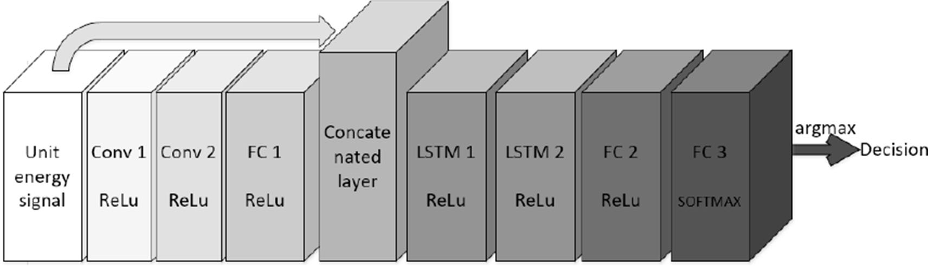
Proposed Method
Cognitive radio using DetectNet

Slide 12
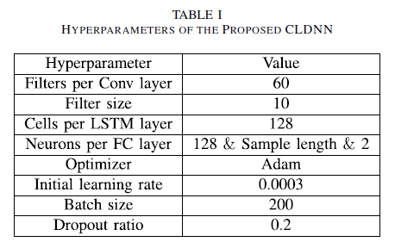
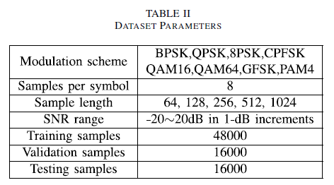
Proposed Method

Slide 13
Dataset
For the dataset, we are taking 11 kinds of digitally modulated signals at different SNRs as positive samples as per RadioML2016.10a, a widely used baseline dataset in modulation recognition tasks. The negative samples are CSCG noises. The entire dataset is partitioned into three different sets for training, validation, and testing with a commonly used split ratio of 8:1:1.
11 modulation types: 8 digital and 3 analog
Digital: BPSK, QPSK, 8PSK, QAM16, QAM64, BFSK, CPFSK, PAM4
Analog: WB-FM, AM-SSB, AM-DSB
Data: 128 sample time domain IQ samples generated on GNU Radio
20 different SNR values: -20 dB to 18 dB (step size of 2)

Slide 14
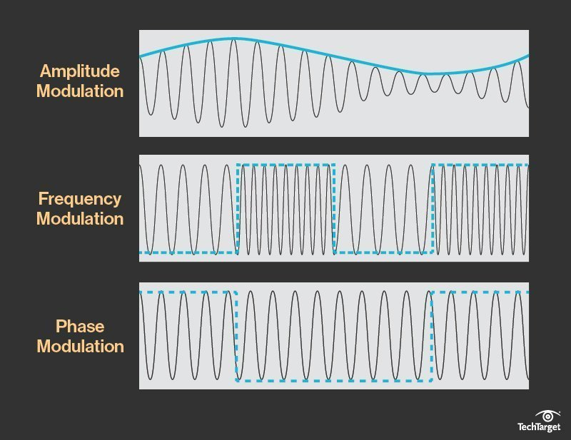
Concept
What is modulation?
Modulation is the process of converting data into radio waves by adding information to an electronic or optical carrier signal. A carrier signal is one with a steady waveform - constant height, or amplitude, and frequency.

Slide 15
Concept
Why use modulation?
The carrier wave used by radio frequency (RF) transmissions doesn't carry much information itself. To include speech or data, another wave has to be superimposed on the carrier wave, thus changing the shape of the carrier wave. The process of doing so is called modulation. To transmit sound, the audio signal must first be converted into an electric signal, using a transducer. After conversion, it is used to modulate a carrier signal.
Analog vs. digital
Modulation schemes can be analog or digital. An analog scheme has an input wave that varies continuously like a sine wave. In digital modulation scheme, voice is sampled at some rate and then compressed and turned into a bit stream, and this in turn is created into a particular kind of wave which is then superimposed on the carrier signal.

Slide 16

Concept
SNR?
The ‘Signal-to-Noise’ ratio or, SNR (in short), is a metric that describes the signal performance in the presence of wireless channel noise (interference). In the linear scale, the SNR is the ratio of the signal power to the noise power. The wireless channel is never noise-free.
What Information does SNR Give Us?
When the signal power drops below a certain threshold, it cannot be detected and decoded faithfully by the receiver.
It tells us the strength of the signal when compared to the channel noise.
A positive SNR indicates that the signal power is greater than the noise power while a negative SNR indicates the opposite.
It is often a common practice to express the SNR in logarithm-based decibel (dB) scale.

Slide 17
Timeline for Work plan
Day 1
Day 24
22-03-2023
Day 54
21-04-2023
Preprocessing the dataset
Selecting and building the deep learning models
Training, validating and Testing the different models
Full Implementation and obtaining the results

Slide 18

H/w and S/w requirements
Python
Keras
Tensorflow
Kaggle notebook

Slide 19
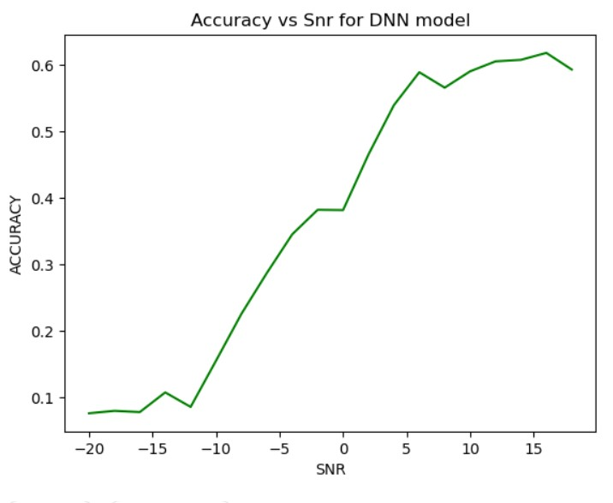
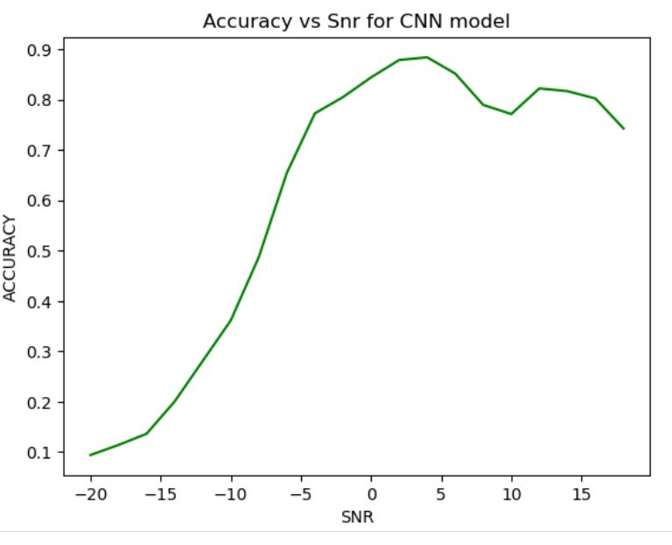
Results
DNN Model
CNN Model

Slide 20
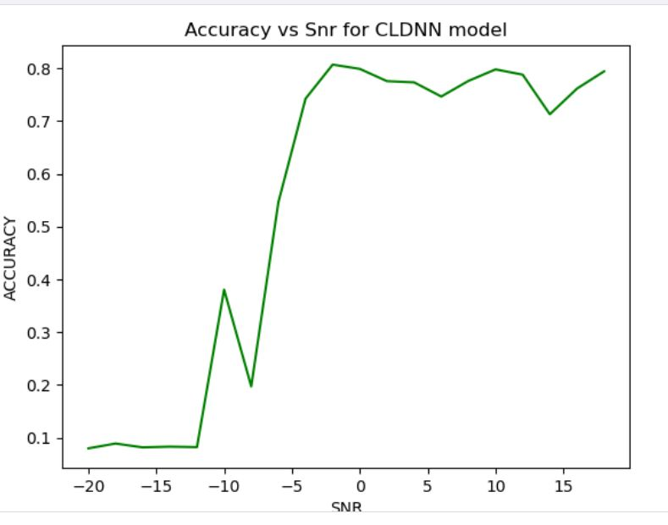
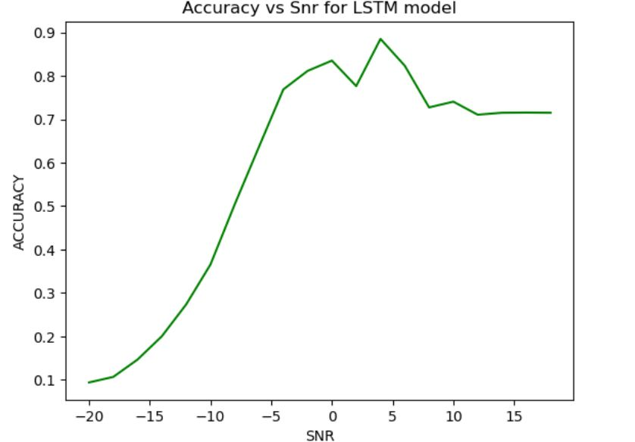
Results
LSTM Model
CLDNN Model

Slide 21
References
https://ieeexplore.ieee.org/document/9020304
https://ieeexplore.ieee.org/document/9295917
https://ieeexplore.ieee.org/document/9738405
https://ieeexplore.ieee.org/document/9297438
https://ieeexplore.ieee.org/document/9587617
https://ieeexplore.ieee.org/document/8539570
https://ieeexplore.ieee.org/document/9663583
https://ieeexplore.ieee.org/document/10014805

Slide 22
Thank you

